Slide 1

05 / 06 / 2025
AI Resume Analyzer
A Guide to Strategic Resume Enhancement and Targeted Job Discovery

Slide 2
CONTENTS
01
02
03
04
Introduction
Phase 1
Phase 2
Challenges

Slide 3
01
INTRODUCTION

Slide 4


OVERVIEW
What it does
Uses GPT-3.5 to read and analyze the structure and content of user uploaded resume
Provides actionable insights to optimize resume
Scrapes LinkedIn based on extracted roles and skills to fetch matching job listings
Why it matters
Reduces the time users spend manually tailoring resumes and searching for jobs
Improves resume quality and targeting by aligning with current job market demands

Slide 5


PROBLEM STATEMENT
The job market today isn’t just about having good skills — it’s about presenting them the right way, fast.
Most of us waste hours tweaking resumes or aimlessly scrolling through LinkedIn listings.
So we asked ourselves why not build something that actually understands your resume and matches it to the right jobs?
That’s what our platform does, we have built a all in one system.

Slide 6
ABOUT PROJECT
Clarity
Focus
Insight
The project provides a clear and structured way to analyze resumes using AI, offering meaningful feedback on strengths, weaknesses, and improvement areas. Users can easily understand how their resume aligns with job expectations.
It combines resume enhancement and job search in one streamlined platform. By focusing on resume content and relevant job roles, it reduces the time and effort needed to apply for suitable positions.
The system uses OpenAI's capabilities to generate insights such as top fixes, summary scores, and suitable job roles. It also scrapes LinkedIn to provide real-time job opportunities matching the resume’s profile.

Slide 7
PHASE-1
STREAMLIT PROCESS

Slide 8
PROCESS FLOW DIAGRAM
Resume Analysis Process
Job Matching Process
Upload PDF or DOCX
Enter role & location
Text Parsing & Chunking
Scrape LinkedIn Jobs
GPT Evaluation
Download CSV

Slide 9
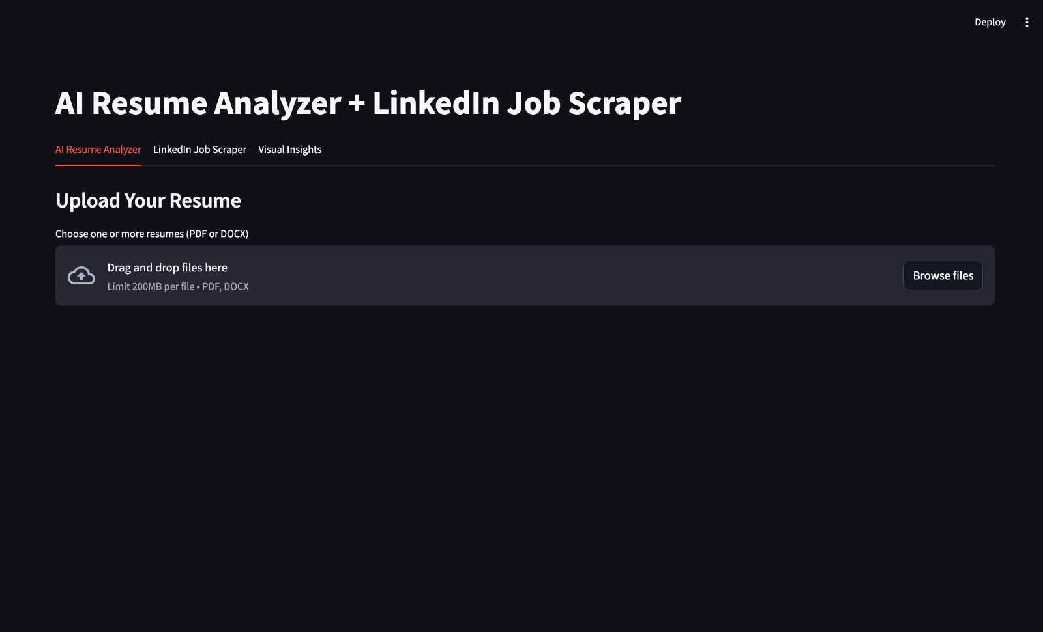
STREAMLIT PROCESS FLOW
1. User Input & Resume Parsing
First, We upload the resume and is parsed using PyPDF2 or python-docx​
Then it’s broken down into readable chunks using LangChain’sRecursiveCharacterTextSplitter.

Slide 10
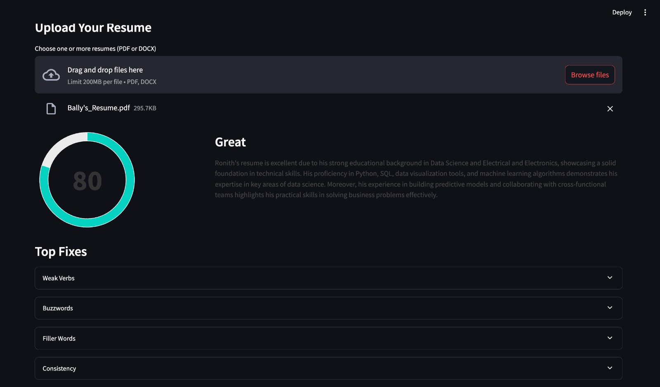
STREAMLIT PROCESS FLOW
2. Chunking
In our case, the LLM is the brain behind the resume analyzer.​
We integrated ChatGPT Turbo 3.5 LLM using LangChain’s ChatOpenAI.

Slide 11
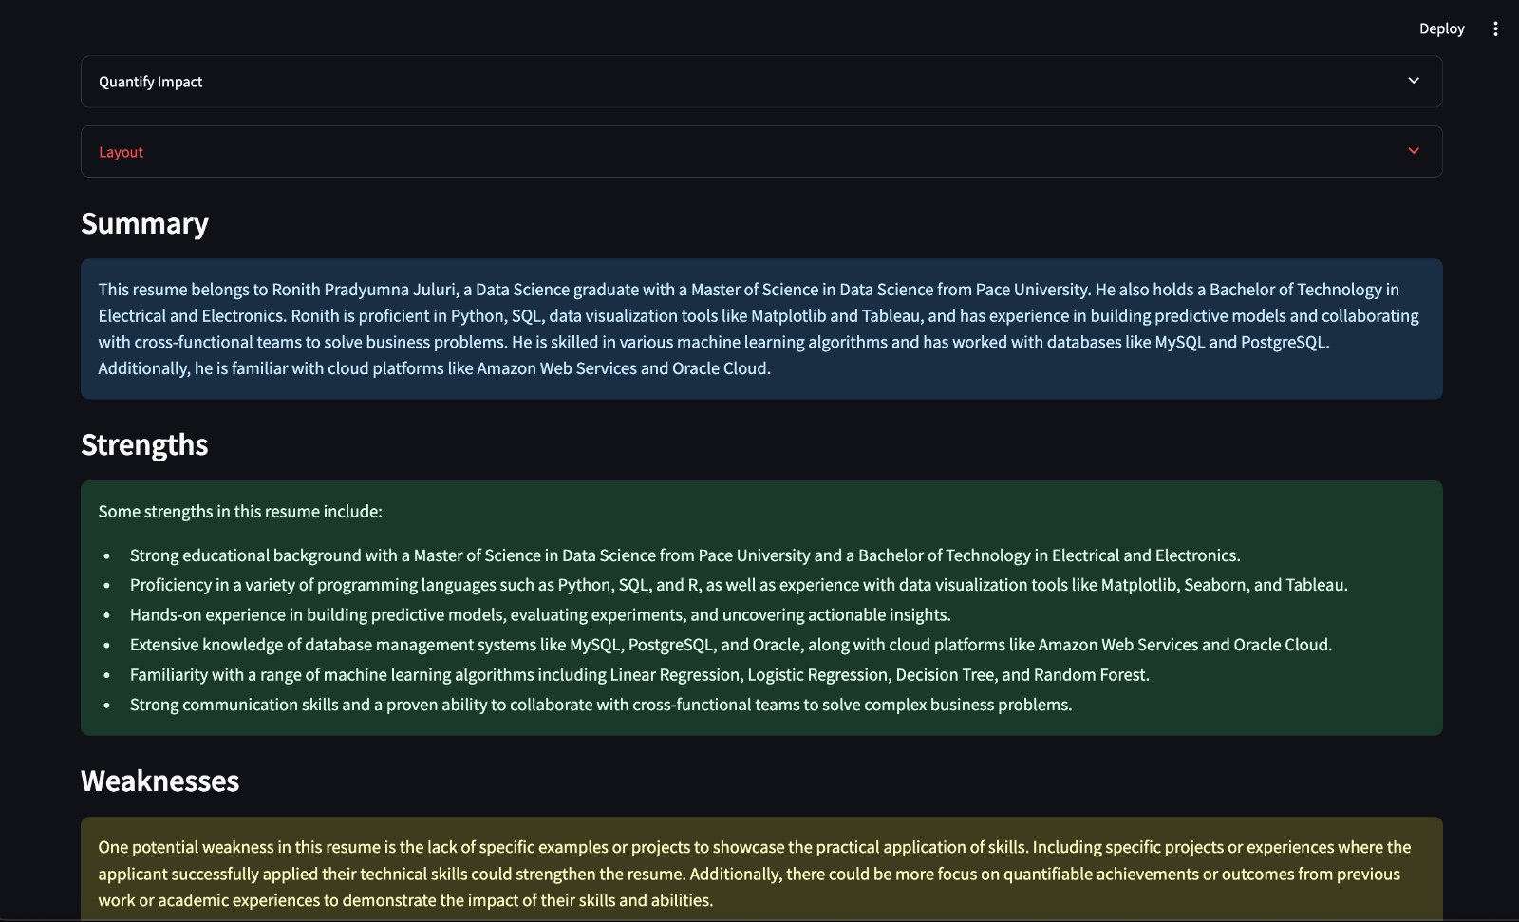
STREAMLIT PROCESS FLOW
3. AI-Powered Resume Analysis
Used embeddings from OpenAIEmbeddings to bring out semantic understanding like score the resume with a summary and top fixes and also Suggest suitable job roles by matching resume content with role expectations.

Slide 12
RESUME SCORING
Needs Improvement
Excellent
Great
Good
90-100
75-89
60-74
<60

Slide 13
PHASE - 2
LINKEDIN SCRAPER

Slide 14
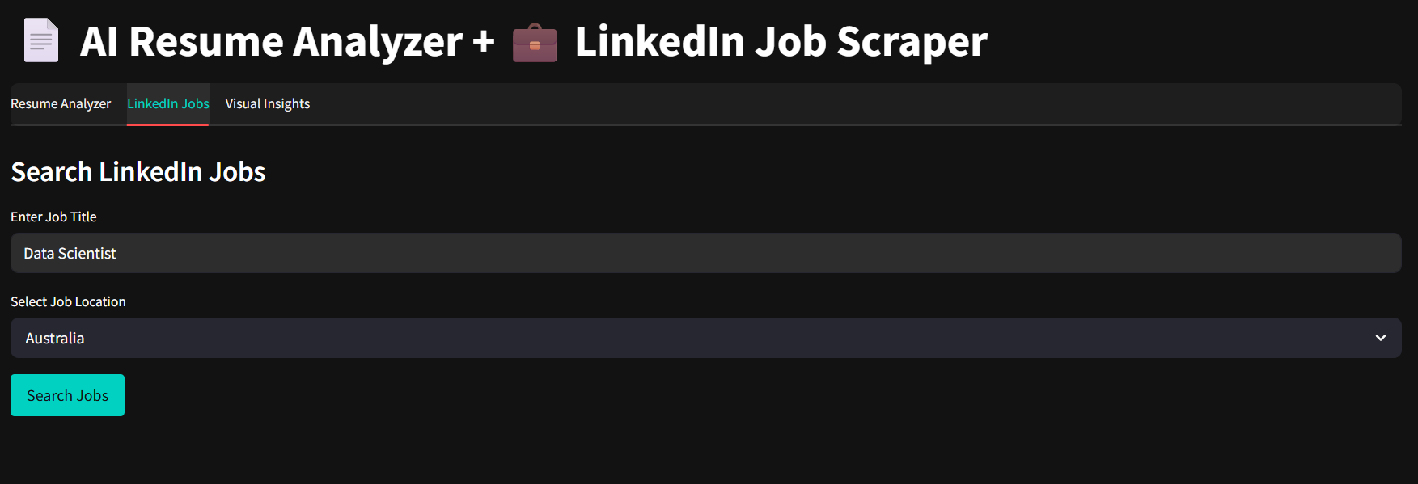
LINKEDIN SCRAPER
What it does?
This module uses Selenium WebDriver to automate LinkedIn job searches, extracting real-time job links based on user-specified role and location. It integrates with the Streamlit app, enabling job search right after resume analysis.

Slide 15
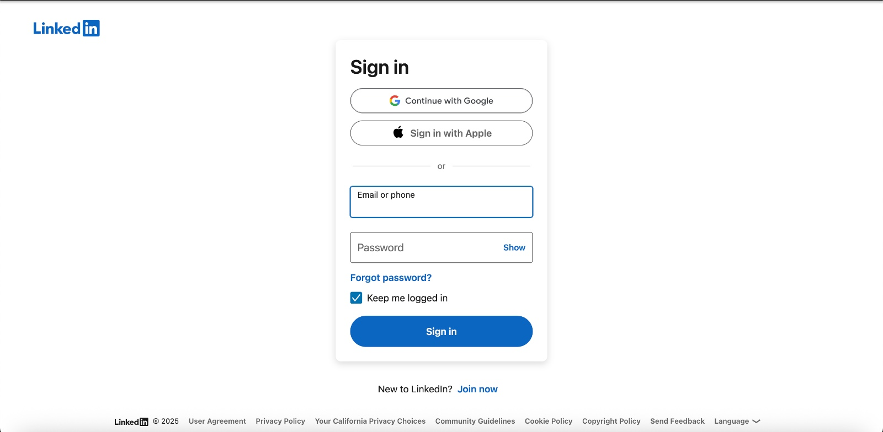
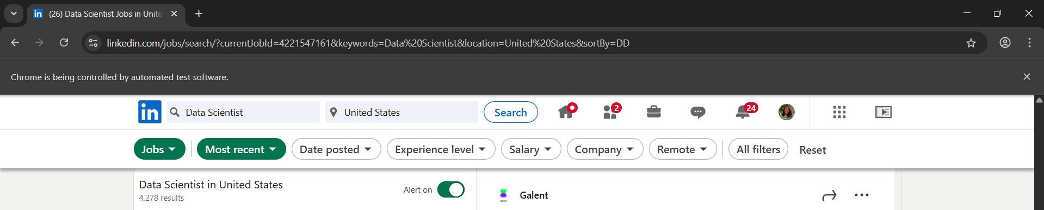
LINKEDIN SCRAPER
2. Browser Automation
Selenium WebDriver launches a browser (Chrome)
A custom LinkedIn job search URL is dynamically created using user inputs
Prompts the user to manually log in.

Slide 16
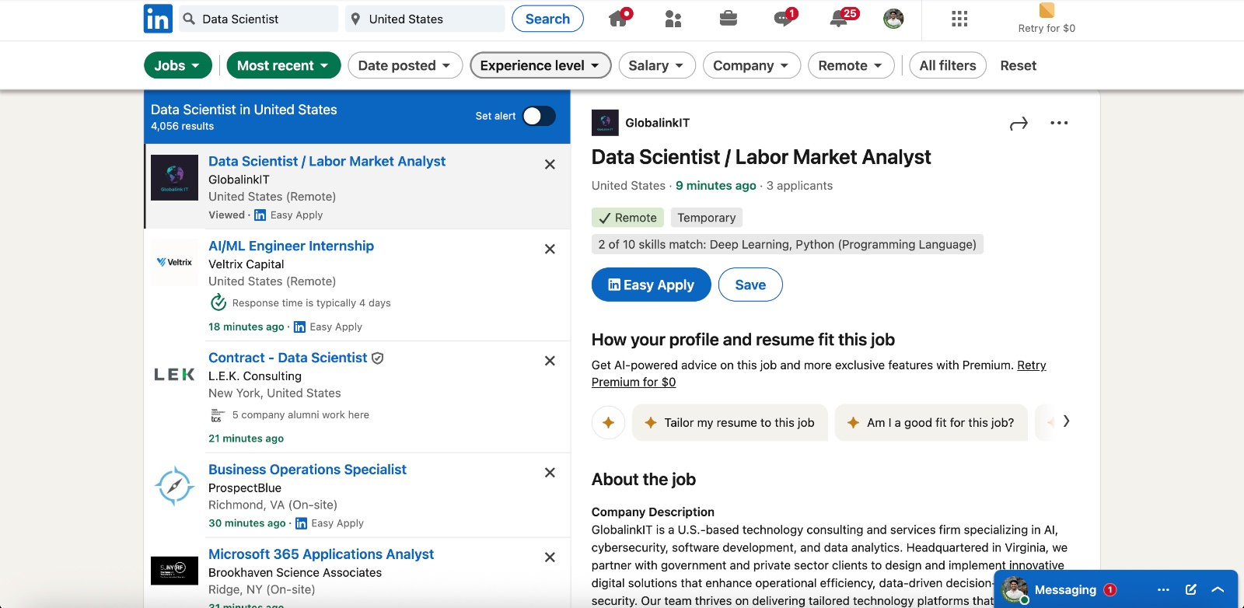
LINKEDIN SCRAPER
3. Job Card Scraping
Once logged in:
Selenium scrolls through job listings.
Extracts job titles, company names, and URLs using CSS selectors.
Filters only valid job cards (not ads or promoted posts).

Slide 17
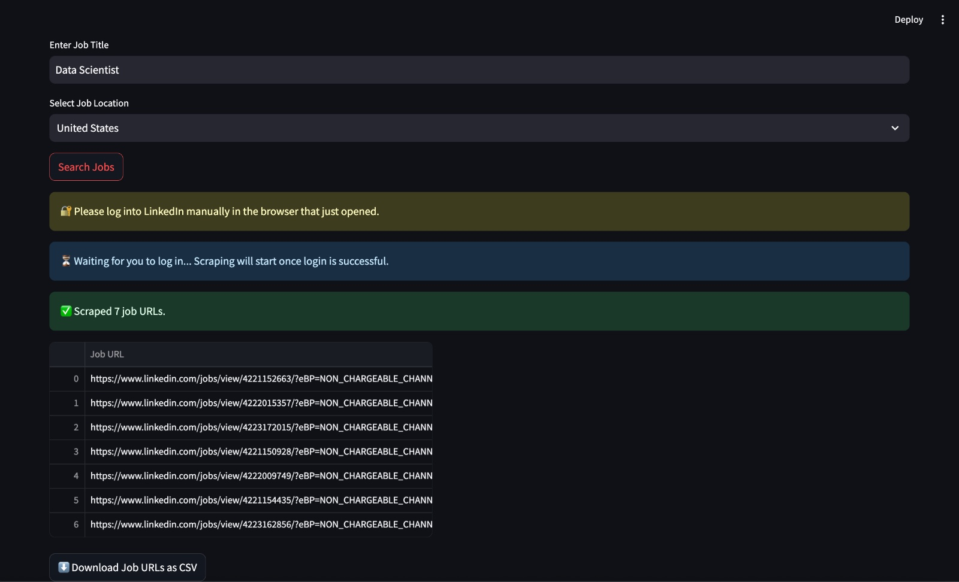
LINKEDIN SCRAPER
4. Output Delivery
Extracted job links are compiled into a DataFrame.
Users can download them as a CSV directly from the Streamlit interface.

Slide 18
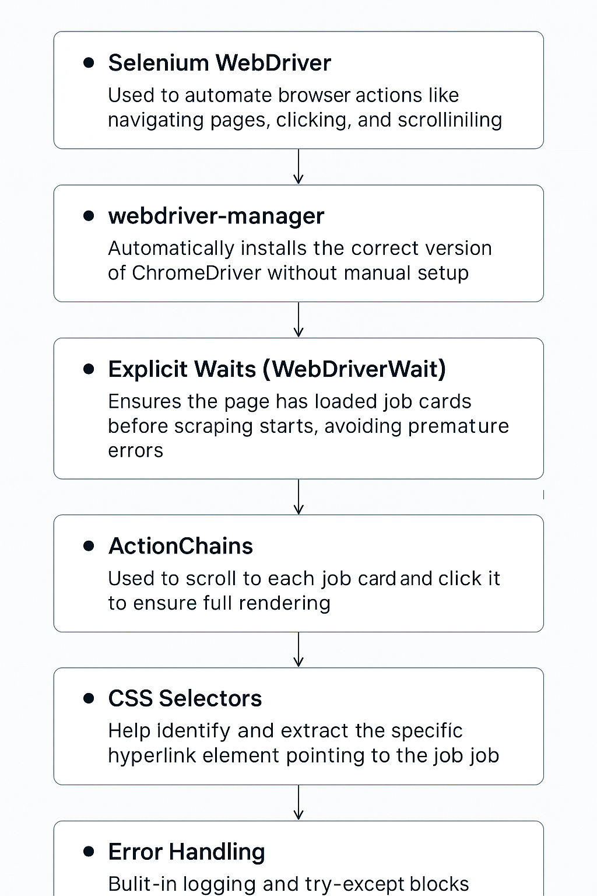
LINKEDIN SCRAPER
Technical concepts behind this working

Slide 19
04
CHALLENGES

Slide 20

Scraper cannot function with LinkedIn accounts using two-factor authentication.
GPT analysis can be limited if resume format is overly visual or unstructured.
Output quality varies depending on the clarity and formatting of the uploaded resume.

Slide 21

IMPACT
Speeds up the job search process by combining resume assessment with live job scraping.
Empowers users to refine their resumes based on AI-generated feedback.
Provided hands-on experience with LLM integration, prompt engineering, and browser automation.

Slide 22

ENHANCEMENTS
Build a mobile-compatible version or lightweight desktop app
Enable cover letter generation tailored to scraped job postings
Integrate multiple job portals: Indeed, Glassdoor, Dice, Monster
Enable auto-apply to suitable jobs using resume data (via RPA or platform APIs)
Implement personalized job alerts via email or notification
Add option to save/bookmark jobs and rank by relevance

Slide 23
THANK YOU

